Slide 1
Topic 13
Arithmetic Components

Slide 2
Components to be discussed
Arithmetic and logic unit (ALU)
Carry lookahead adder
Incrementer
Magnitude comparator
Multiplier

Slide 3
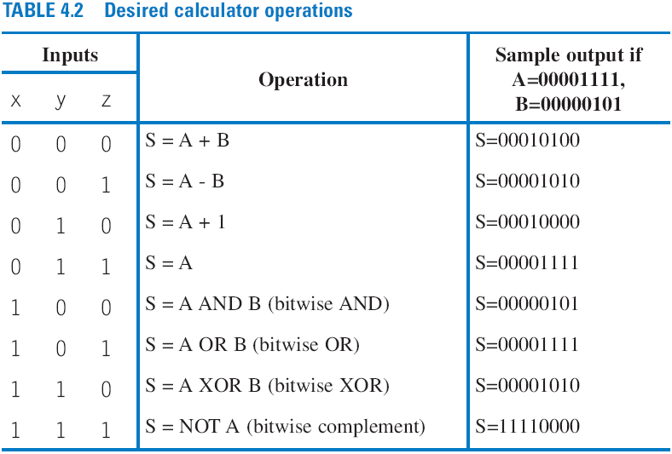
Arithmetic-Logic Unit: ALU
ALU: Component that can perform any of various arithmetic (add, subtract, increment, etc.) and logic (AND, OR, etc.) operations, based on control inputs
Key component in computer

Slide 4
Multifunction Calculator with an ALU
ALU functions selected by a mux
  But too many wires
  Wasted power computing all those operations when at any time you only use one of the results
DIP switches
1
0
8
8
A
B
+
-
+1
AND
OR
X
OR
N
O
T
Wasted
8
power
8
8
8
8
8
8
8
A lot of wires
1
0
x
0
1
2
3
4
5
6
7
y
s2
8-bit 8
⋅
1
z
s1
s0
e
8
Id
8-bit
r
e
g
is
t
er
clk
C
A
L
C
8
LEDs

Slide 5
Carry-Ripple Adder
Carry-ripple adder
  4-bit adder: Adds two 4-bit numbers, generates 5-bit output
    5-bit output can be considered 4-bit “sum” plus 1-bit “carry out”
  Can easily build any size adder
ca
rr
ies:
c3
c2
c1
cin
B:
b3
b2
b1
b0
A:
+
a3
a2
a1
a0
cout
s3
s2
s1
s0
a3
b3
a2
b2
a1
b1
a0
b0
ci
a
b
ci
a
b
ci
a
b
ci
a
b
ci
a3
a2
a1
a0
b3
b2
b1
b0
F
A
F
A
F
A
F
A
4-bit adder
ci
c
o
s
c
o
s
c
o
s
c
o
s
c
o
s3
s2
s1
s0
c
o
s3
s2
s1
s0
(
a
)
(
b
)

Slide 6
Carry-Ripple Adder’s Behavior
0
0
0
0
0
0
0
0
0
0
0
0
a
b
ci
a
b
ci
a
b
ci
a
b
ci
F
A
F
A
F
A
F
A
Assume all inputs initially 0
c
o
s
c
o
s
c
o
s
c
o
s
0
0
0
0
0
0
0
0
0
0
0
1
0
0
1
0
0
1
1
0
0111+0001
(answer should be 01000)
a
b
ci
a
b
ci
a
b
ci
a
b
ci
F
A
F
A
F
A
F
A
c
o
s
c
o
s
c
o
s
c
o
s
0
0
1
0
0
0
c
o2
1
c
o1
1
c
o0
0
O
utput a
f
t
er 2 ns (1
F
A del
a
y)
Wrong answer -- something wrong? No -- just need more time for carry to ripple through the chain of full adders.

Slide 7
Carry-Ripple Adder’s Behavior
0
0
0
1
0
0
1
0
1
1
1
0
0111+0001
(answer should be 01000)
a
b
ci
a
b
ci
a
b
ci
a
b
ci
F
A
F
A
F
A
F
A
c
o
s
c
o
s
c
o
s
c
o
s
0
1
1
0
0
1
c
o1
0
0
Outputs after 4ns (2 FA delays)
(
b
)
0
0
1
0
1
1
0
1
1
0
0
1
0
a
b
ci
a
b
ci
a
b
ci
a
b
ci
F
A
F
A
F
A
F
A
c
o
s
c
o
s
c
o
s
c
o
s
1
1
1
a
0
0
c
o2
0
0
0
Outputs after 6ns (3 FA delays)
(
c
)
0
0
1
1
0
1
1
0
1
1
1
0
0
a
b
ci
a
b
ci
a
b
ci
a
b
ci
F
A
F
A
F
A
F
A
c
o
s
c
o
s
c
o
s
c
o
s
1
1
1
0
1
0
(
d
)
0
0
Output after 8ns (4 FA delays)
Correct answer appears after 4 FA delays

Slide 8
Faster Adder
a3
b3
a2
b2
a1
b1
a0
b0
ci
Faster adder – Use two-level combinational logic design process
  4-bit two-level adder is big
    9 input and 5 output combination circuit
  Pro: Fast
    2 gate-level delays
  Con: Large
    Truth table would have 2⁽⁴⁺⁴⁺¹⁾ =512 rows
    Plot shows 4-bit adder would use about 500 gates
Two-level: AND level followed by ORs
c
o
s3
s2
s1
s0
10000
8000
6000
4000
2000
0
1
2
3
4
5
6
7
8
N

Slide 9
Recall Full Adder
A
Full-Adder
Sum
Sum = A’B’C + A’BC’ + AB’C’ + ABC
= A’(B’C + BC’) + A(B’C’ + BC)
= A’(B ⊕ C) + A(B ⊕ C)’
(let B ⊕ C = D)
= A’D + AD’
= A ⊕ D
= A ⊕ B ⊕ C
Carry = A’BC + AB’C + ABC’ + ABC
= A’BC + AB’C + AB (C’ + C)
= A’BC + AB’C + AB
= (A’C + A)B + A(B’C + B)
= (C + A)B + A(C + B)
= CB + AB + AC + AB
= AB + AC + BC
= (A’B+AB’) C + AB (C’+C)
= (A ⊕ B)C + AB
B
C
Carry
A | B | C | Sum | Carry
0 | 0 | 0 | 0 | 0
0 | 0 | 1 | 1 | 0
0 | 1 | 0 | 1 | 0
0 | 1 | 1 | 0 | 1
1 | 0 | 0 | 1 | 0
1 | 0 | 1 | 0 | 1
1 | 1 | 0 | 0 | 1
1 | 1 | 1 | 1 | 1
Sum = A’B’C + A’BC’ + AB’C’ + ABC
= Σ m(1, 2, 4, 7)
Carry = A’BC + AB’C + ABC’ + ABC
= Σ m(3, 5, 6, 7)

Slide 10
Faster Adder – Intuitive Attempt at “Lookahead”
Produce carries directly
  c1 = a0b0 + a0c0 + b0c0
  c2 = a1b1 + a1c1 + b1c1
  = a1b1 + a1(a0b0+a0c0+b0c0) + b1(a0b0+a0c0+b0c0)
  c3 = a2b2 + a2c2 + b2c2
  = …… (replace c2)
  c4 = a3b3 + a3c3 + b3c3
  = …… (replace c3)
Carry outputs of all FAs are represented with a0, a1, a2, a3, b0, b1, b2, b3, and c0

Slide 11
Faster Adder – Intuitive Attempt at “Lookahead”
Idea: Modify carry-ripple adder
  don’t wait for carry to ripple, but rather directly compute from inputs of earlier stages
  Called “lookahead” because current stage “looks ahead” at previous stages
a3
b3
a2
b2
a1
b1
a0
b0
c0
look
look
look
ahead
ahead
ahead
c3
c2
c1
c0
F
A
c4
stage 3
stage 2
stage 1
stage 0
c
out
s3
s2
s1
s0
Notice – no rippling of carry

Slide 12
Faster Adder – Intuitive Attempt at “Lookahead”
a3
b3
a2
b2
a1
b1
a0
b0
c0
Carry lookahead logic
  No waiting for ripple
  2-layer SOP logic
Problem
  Equations get too big
  Not efficient
  Need a better form of lookahead
look
look
look
ahead
ahead
ahead
c3
c2
c1
c0
F
A
c4
stage 3
stage 2
stage 1
stage 0
c
out
s3
s2
s1
s0
c1 = b0c0 + a0c0 + a0b0
c2 = b1b0c0 + b1a0c0 + b1a0b0 + a1b0c0 + a1a0c0 + a1a0b0 + a1b1
  c3 = b2b1b0c0 + b2b1a0c0 + b2b1a0b0 + b2a1b0c0 + b2a1a0c0 + b2a1a0b0 + b2a1b1 + a2b1b0c0 + a2b1a0c0 + a2b1a0b0 + a2a1b0c0 + a2a1a0c0 + a2a1a0b0 + a2a1b1 + a2b2
Huge number of gates

Slide 13
Better Form of Lookahead
Recall Full Adder, another equation for carry
  Carry = ab + (a ⊕ b)c
Define two terms
  Propagate: P = a ⊕ b
  Generate: G = ab
Compute lookahead carries from P and G terms, not from external inputs
  Cout = G + Pc
    c1 = a0b0 + (a0⊕b0)c0 = G0 + P0c0
    c2 = a1b1 + (a1⊕b1)c1 = G1 + P1c1
    c3 = a2b2 + (a2⊕b2)c2 = G2 + P2c2

Slide 14
Better Form of Lookahead
a3
b3
a3
b3
a2
b2
a2
b2
a1
b1
a1
b1
a0
a0
b0
c0
“Bad” lookahead
b0
cin
Half-adder
Half-adder
Half-adder
Half-adder
look
look
look
ahead
ahead
ahead
c3
c2
c1
c0
C
a
r
r
G3
P3
F
A
c3
G2
P2
c2
G1
P1
c1
G0
P0
c0
y
-loo
k
ahead lo
g
ic
c4
stage 3
stage 2
stage 1
stage 0
c
out
c
out
s3
s3
s2
s2
(
b
)
s1
s1
s0
s0
With P & G, the carry lookahead equations are much simpler
  Equations before plugging in
    c1 = G0 + P0c0
    c2 = G1 + P1c1
    c3 = G2 + P2c2
    cout = G3 + P3c3
After plugging in:
c1 = G0 + P0c0
c2 = G1 + P1c1 = G1 + P1(G0 + P0c0)
c2 = G1 + P1G0 + P1P0c0
c3 = G2 + P2c2 = G2 + P2(G1 + P1G0 + P1P0c0)
c3 = G2 + P2G1 + P2P1G0 + P2P1P0c0
cout = G3 + P3G2 + P3P2G1 + P3P2P1G0 + P3P2P1P0c0
Much simpler than the intuitive lookahead

Slide 15
Better Form of Lookahead (cont.)
a3
b3
a2
b2
a1
b1
a0
b0
cin
SPG
Half-adder
block
Half-adder
Half-adder
Half-adder
Call this sum/propagate/generate (SPG) block
C
a
r
r
G3
P3
c3
G2
P2
c2
G1
P1
c1
G0
P0
c0
y
-loo
k
ahead lo
g
ic
c
out
s3
s2
(
b
)
s1
s0
P3
G3
P2
G2
P1
G1
P0
G0
c0
C
a
r
r
y
-loo
k
ahead lo
g
ic
S
tage 4
S
tage 3
S
tage 2
S
tage 1
c2 = G1 + P1G0 + P1P0c0
c1 = G0 + P0c0
c
c3 = G2 + P2G1 + P2P1G0 + P2P1P0c0
out = G3 + P3G2 + P3P2G1 + P3P2P1G0 + P3P2P1P0c0
(
c
)

Slide 16
Better Form of Lookahead (cont.)
a3
b3
a3
b3
a2
b2
a2
b2
a1
b1
a1
b1
a0
a0
b0
c0
“Bad” lookahead
b0
cin
Half-adder
Half-adder
Half-adder
Half-adder
look
look
look
ahead
ahead
ahead
c3
c2
c1
c0
C
a
r
r
G3
P3
F
A
c3
G2
P2
c2
G1
P1
c1
G0
P0
c0
y
-loo
k
ahead lo
g
ic
c4
stage 3
stage 2
stage 1
stage 0
c
out
c
out
s3
s3
s2
s2
(
b
)
s1
s1
s0
s0
With P & G, sum outputs are
    s0 = P0 ⊕ cin
    s1 = P1 ⊕ c1
    s2 = P2 ⊕ c2
    s3 = P3 ⊕ c3

Slide 17
Carry-Lookahead Adder -- High-Level View
a3
b3
a2
b2
a1
b1
a0
b0
c0
a
b
cin
a
b
cin
a
b
cin
a
b
cin
SPG block
SPG block
SPG block
SPG block
P
G
P
G
P
G
P
G
P3
G3
c3
P2
G2
c2
P1
G1
c1
P0
G0
c0
cout
4-bit carry-lookahead logic
cout
s3
s2
s1
s0
Fast -- only 4 gate level delays
  Each stage has SPG block with 2 gate levels
  Carry-lookahead logic quickly computes the carry from the propagate and generate bits using 2 gate levels inside
Reasonable number of gates
Nice balance between intuitive lookahead and pure combinational logic

Slide 18
Cascading Adders
Example: construct an 8-bit adder with two 4-bit adders
a7
a6
a5
a4
b7
b6
b5
b4
a3
a2
a1
a0
b3
b2
b1
b0
a3
a2
a1
a0
b3
b2
b1
b0
a3
a2
a1
a0
b3
b2
b1
b0
a7.. a0
b7.. b0
4-bit adder
ci
4-bit adder
ci
8-bit adder
ci
c
o
s3
s2
s1
s0
c
o
s3
s2
s1
s0
c
o
s7.. s0
c
o
s7
s6
s5
s4
s3
s2
s1
s0
(
a
)
(
b
)

Slide 19
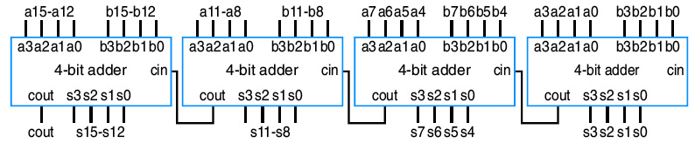
Cascading Adders to CLA Addres
Example: construct an 16-bit adder with four 4-bit adders
Again, carries cause propagation delay

Slide 20
Carry-Lookahead Adder -- High-Level View
Adding two more outputs: P, G
a3
b3
a2
b2
a1
b1
a0
b0
c0
a
b
cin
a
b
cin
a
b
cin
a
b
cin
SPG block
SPG block
SPG block
SPG block
P
G
P
G
P
G
P
G
c0
P3
G3
c3
P2
G2
c2
P1
G1
c1
P0
G0
cout
4-bit carry-lookahead logic
cout
s3
s2
s1
s0
P
G
P = P3P2P1P0
G = G3+P3G2+P3P2G1+P3P2P1G0

Slide 21
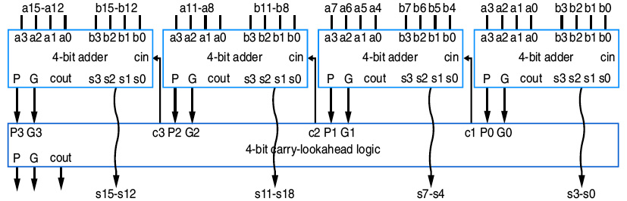
Cascading Adders to CLA Addres
Example: construct an 16-bit adder with four 4-bit adders
Again, carries cause propagation delay
c0
P = P3P2P1P0
G = G3+P3G2+P3P2G1+P3P2P1G0
C1 = G0 + P0C0
C2 = G1 + P1C1 = G1+P1G0+P1P0C0
……

Slide 22
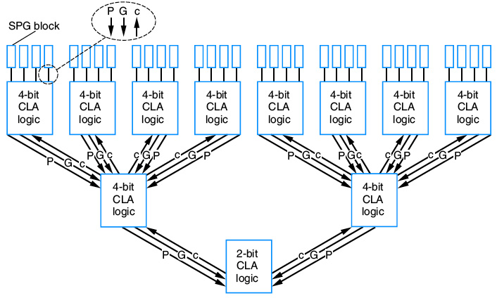
CLA Adders
Multi-level CLA structure

Slide 23
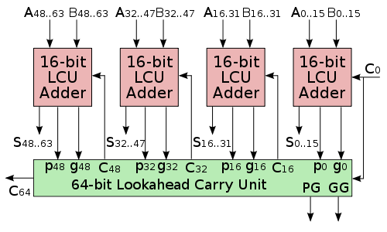
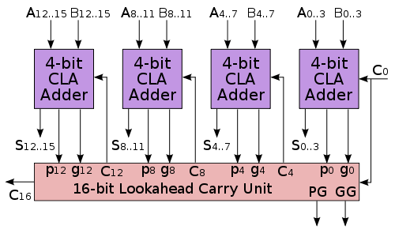
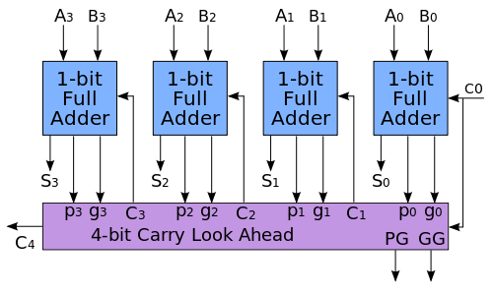
CLA Adders
Source: www.wikipedia.org

Slide 24
Adder Example: DIP-Switch-Based Adding Calculator
To prevent spurious values from appearing at output, can place register at output
DIP switches
1
0
a7..a0
b7..b0
8-bit adder
ci
0
c
o
s7..s0
e
ld
clk
8-bit register
C
A
L
C
LEDs

Slide 25
Incrementer
Traditional design procedure
  Capture truth table
  Derive equation for each output
    c0 = a3a2a1a0
    ...
    s0 = a0’
  Results in small and fast circuit
  Works for small operand
    larger operand leads to exponential growth, like for N-bit adder
I
nputs
O
utputs
a3
a2
a1
a0
c0
s3
s2
s1
s0
0
0
0
0
0
0
0
0
1
0
0
0
1
0
0
0
1
0
0
0
1
0
0
0
0
1
1
0
0
1
1
0
0
1
0
0
0
1
0
0
0
0
1
0
1
0
1
0
1
0
0
1
1
0
0
1
1
0
0
0
1
1
1
0
1
1
1
0
1
0
0
0
1
0
0
0
0
1
0
0
1
1
0
0
1
0
1
0
1
0
1
0
1
0
0
1
0
1
1
1
0
1
1
0
1
1
0
0
1
1
0
0
0
1
1
0
1
1
1
0
1
0
1
1
1
0
1
1
1
0
0
1
1
1
1
1
1
1
1
1
0
0
0
0

Slide 26
Incrementer
Alternative incrementer design
  Could use N-bit adder with one of the inputs set to 1
  Use half-adders (adds two bits) rather than full-adders (adds three bits)
  Slower but simpler
a3
a2
a1
a0
1
carries:
0 1 1
0 0 1 1
a
b
a
b
a
b
a
b
a3
a2
a1
a0
unused
HA
HA
HA
HA
+1
+
1
c
o
s3
s2
s1
s0
c
o
s
c
o
s
c
o
s
c
o
s
0
0
1
0
0
c
o
s3
s2
s1
s0
(
b
)
(
a
)

Slide 27
Comparators
N-bit equality comparator: Outputs 1 if two N-bit numbers are equal
Example: 4-bit equality comparator with inputs A and B
  Approach 1: combinational design procedure
  Approach 2: recall functionality of XOR and XNOR
0110 = 0111 ?
a3
b3
a2
b2
a1
b1
a0
b0
0
0
1
1
1
1
0
1
1
1
1
0
a3
a2
a1
a0
b3
b2
b1
b0
4-bit equality comparator
eq
(
b
)
0
eq
(
a
)

Slide 28
Magnitude Comparator
N-bit magnitude comparator:
  Indicates whether A>B, A=B, or A<B, for its two N-bit inputs A and B
  Design approach 1: combinational design procedure
  Design approach 2: Consider how compare by hand.
A=1011
B=1001
1011
1001
Equal
1011
1001
Equal
1011
1001
Unequal
So A > B

Slide 29
Magnitude Comparator
By-hand example leads to idea for design
  Start at left, compare each bit pair, pass results to the right
  Each stage has 3 inputs indicating results of higher stage, passes results to lower stage
a3
b3
a2
b2
a1
b1
a0
b0
a
b
a
b
a
b
a
b
Igt
in_gt
out_gt
in_gt
out_gt
in_gt
out_gt
in_gt
out_gt
AgtB
Ieq
in_eq
out_eq
in_eq
out_eq
in_eq
out_eq
in_eq
out_eq
AeqB
Ilt
in_lt
out_lt
in_lt
out_lt
in_lt
out_lt
in_lt
out_lt
AltB
Stage 3
Stage 2
Stage 1
Stage 0
(
a
)
0
Igt
a3
a2
a1
a0
b3
b2
b1
b0
AgtB
1
Ieq
4-bit magnitude comparator
AeqB
0
Ilt
AltB
(
b
)

Slide 30
Magnitude Comparator
a3
b3
a2
b2
a1
b1
a0
b0
a
b
a
b
a
b
a
b
Igt
in_gt
out_gt
in_gt
out_gt
in_gt
out_gt
in_gt
out_gt
AgtB
Ieq
in_eq
out_eq
in_eq
out_eq
in_eq
out_eq
in_eq
out_eq
AeqB
Ilt
in_lt
out_lt
in_lt
out_lt
in_lt
out_lt
in_lt
out_lt
AltB
Stage 3
Stage 2
Stage 1
Stage 0
Each stage:
  out_gt = in_gt + (in_eq * a * b’)
    A>B (so far) if already determined in higher stage, or if higher stages equal but in this stage a=1 and b=0
  out_lt = in_lt + (in_eq * a’ * b)
    A<B (so far) if already determined in higher stage, or if higher stages equal but in this stage a=0 and b=1
  out_eq = in_eq * (a XNOR b)
    A=B (so far) if already determined in higher stage and in this stage a=b too
  Simple circuit inside each stage, just a few gates (not shown)

Slide 31
Magnitude Comparator
How does it work?
1011 = 1001 ?
1
=
1
0
0
1
0
1
1
a3
b3
a2
b2
a1
b1
a0
b0
a
b
a
b
a
b
a
b
Igt
0
in_gt
out_gt
0
in_gt
out_gt
in_gt
out_gt
in_gt
out_gt
A
gtB
Ieq=1 causes this stage to compare
Ieq
1
1
0
in_eq
out_eq
0
in_eq
out_eq
in_eq
out_eq
in_eq
out_eq
A
eqB
I
lt
in_lt
out_lt
in_lt
out_lt
in_lt
out_lt
in_lt
out_lt
A
ltB
S
tage3
S
tage2
S
tage1
S
tage0
(
a
)
1
1
0
=
0
1
0
1
1
a3
b3
a2
b2
a1
b1
a0
b0
a
b
a
b
a
b
a
b
Igt
0
in_gt
out_gt
in_gt
out_gt
0
in_gt
out_gt
in_gt
out_gt
A
gtB
Ieq
1
in_eq
out_eq
in_eq
out_eq
1
in_eq
out_eq
in_eq
out_eq
A
eqB
I
lt
0
in_lt
out_lt
in_lt
out_lt
0
in_lt
out_lt
in_lt
out_lt
A
ltB
S
tage3
S
tage2
S
tage1
S
tage0
(
b
)

Slide 32
Magnitude Comparator
1011 = 1001 ?
1
1
0
0
1
>
0
1
1
a3
b3
a2
b2
a1
b1
a0
b0
Final answer appears on the right
Takes time for answer to “ripple” from left to right
Thus called “carry-ripple style” even though there’s no “carry” involved
a
b
a
b
a
b
a
b
Igt
0
in_gt
out_gt
in_gt
out_gt
in_gt
out_gt
1
in_gt
out_gt
A
gtB
Ieq
1
in_eq
out_eq
in_eq
out_eq
in_eq
out_eq
0
in_eq
out_eq
A
eqB
I
lt
0
in_lt
out_lt
in_lt
out_lt
in_lt
out_lt
0
in_lt
out_lt
A
ltB
S
tage3
S
tage2
S
tage1
S
tage0
(
c
)
a
1
1
0
0
1
0
1
1
a3
b3
a2
b2
a1
b1
a0
b0
a
b
a
b
a
b
a
b
Igt
0
in_gt
out_gt
in_gt
out_gt
in_gt
out_gt
in_gt
out_gt
1
A
gtB
Ieq
1
in_eq
out_eq
in_eq
out_eq
in_eq
out_eq
in_eq
out_eq
0
A
eqB
I
lt
0
in_lt
out_lt
in_lt
out_lt
in_lt
out_lt
in_lt
out_lt
0
A
ltB
S
tage3
S
tage2
S
tage1
S
tage0
(
d
)

Slide 33
Magnitude Comparator Example:
Minimum of Two Numbers
Design a combinational component that finds the minimum of two 8-bit numbers
  Solution: Use 8-bit magnitude comparator and 8-bit 2x1 mux
    If A<B, pass A through mux. Else, pass B.
11000000
01111111
MIN
A
B
8
8
a
8
8
8
8
A
B
A
B
1
I
1
I
0
M
in
0
Igt
AgtB
0
s
C
1
Ieq
8-bit magnitude comparator
AeqB
8-bit
0
Ilt
AltB
0
2x1 mux
8
8
(
b
)
C
(
a
)
01111111
What if inputs are 2’s complement???

Slide 34
Multiplier
Can build multiplier that mimics multiplication by hand
  Notice that multiplying multiplicand by 1 is same as ANDing with 1

Slide 35
Multiplier – Array Style
Generalized representation of multiplication by hand

Slide 36
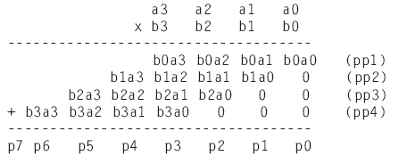
Multiplier – Array Style
Multiplier design – array of AND gates
a3
a2
a1
a0
b0
pp1
b1
pp2
0
0
b2
+ (5-bit)
pp3
0
0
b3
A
B
+ (6-bit)
*
pp4
P
0
0
0
+ (7-bit)
Block symbol
p7..p0

Slide 37
Smaller Multiplier -- Sequential (Add-and-Shift) Style
Add-and-Shift
  Don’t compute all partial products simultaneously
  Rather, compute one at a time (similar to by hand), maintain a running sum
Step 1
Step 2
Step 3
Step 4
0 1 1 0
0 1 1 0
0 1 1 0
0 1 1 0
∗
0 0 1
1
∗
0 0
1
1
∗
0
0
1 1
∗
0
0 1 1
(running sum)
0 0 0 0
0 0 1 1 0
0 1 0 0 1 0
0 0 1 0 0 1 0
(partial product)
+
0 1 1 0
+
0 1 1 0
+
0 0 0 0
+
0 0 0 0
(new running sum)
0 0 1 1 0
0 1 0 0 1 0
0 0 1 0 0 1 0
0 0 0 1 0 0 1 0

Slide 38
Smaller Multiplier -- Sequential (Add-and-Shift) Style
multiplier
multiplicand
Design circuit that computes one partial product at a time, adds to running sum
  Note that shifting running sum right (relative to partial product) after each step ensures partial product added to correct running sum bits
multiplicand
Controller
register (4)
load
mdld
multiplier
4-bit adder
m
register (4)
r
ld
load
mr3
mr2
mr1
mr0
rsload
load
rsclear
clear
running sum
rsshr
shr
register (8)
start
Step 1
Step 2
Step 3
Step 4
0 1 1 0
0 1 1 0
0 1 1 0
0 1 1 0
product
+
0 0 1
1
+
0 0
1
1
+
0
0
1 1
+
0
0 1 1
What about carry?
0 0 0 0
0 0 1 1 0
0 1 0 0 1 0
0 0 1 0 0 1 0
(running sum)
+
0 1 1 0
+
0 1 1 0
+
0 0 0 0
+
0 0 0 0
(partial product)
What if 2’s complement?
0 0 1 1 0
0 1 0 0 1 0
0 0 1 0 0 1 0
0 0 0 1 0 0 1 0
(new running sum)

Slide 39
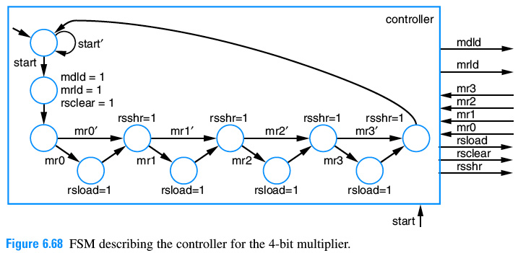
Smaller Multiplier – Controller Design

